Slide 1
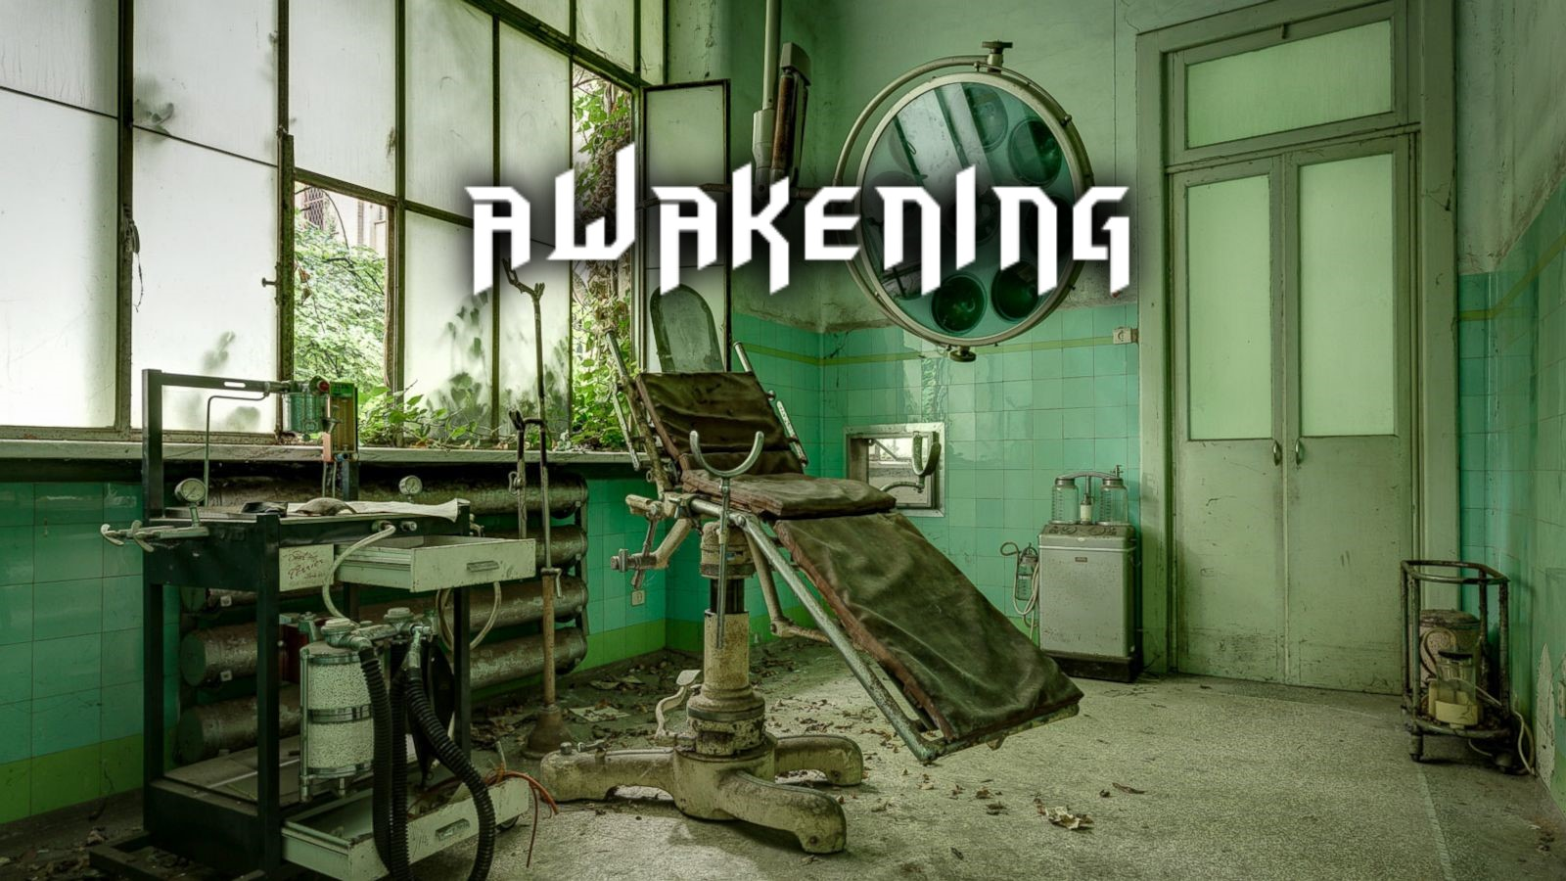
Awakening T-5 Capstone
Created by David Holman, Nima Gopali, and Martin Hartsfield

Slide 2
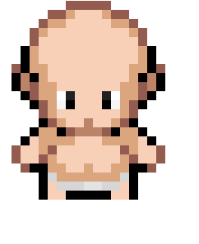

Project Guidelines
Use existing code base from Group 2
Create a Swing GUI based game
Use Agile methods
Manage tasks within backlog(azure devops)

Slide 3
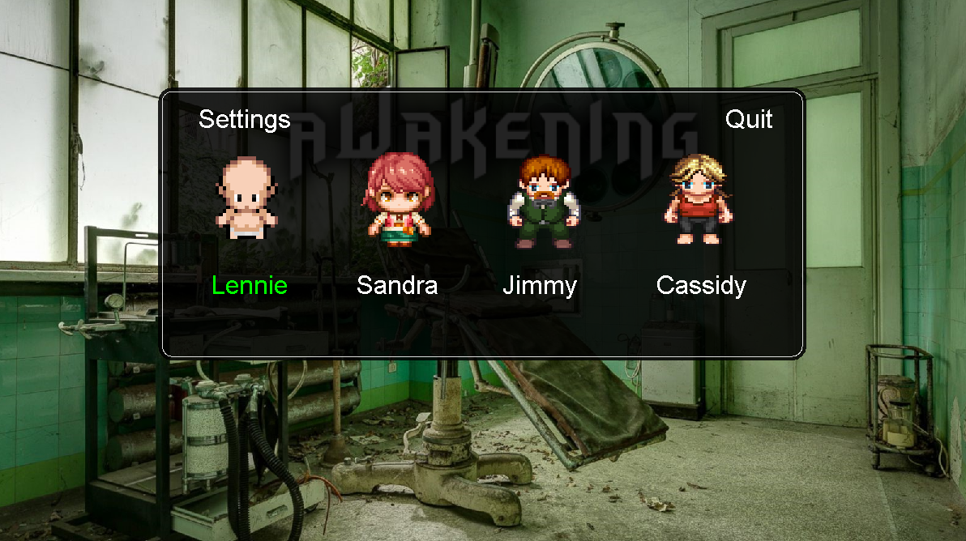
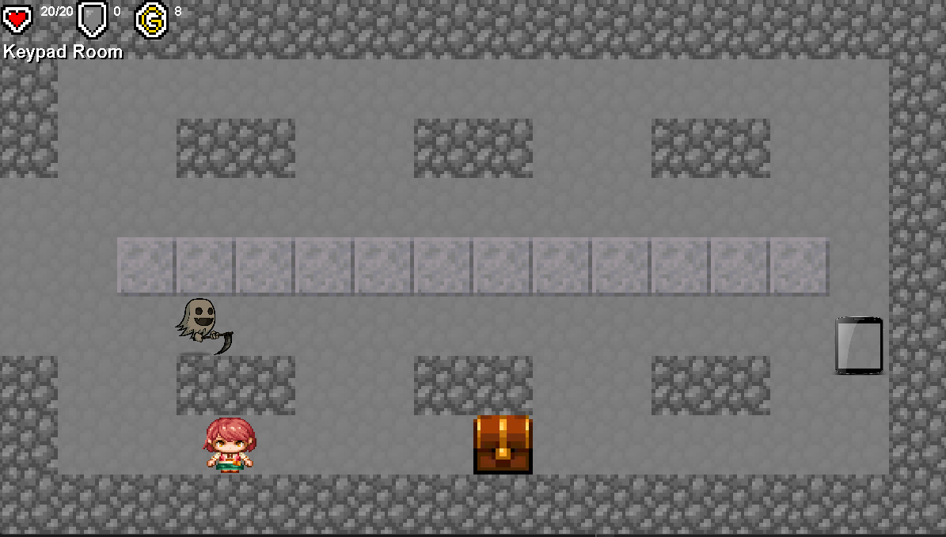
Game Features
Playable game
Ability to navigate through world
Map is shown
Weapons can be picked up and used to fight ghosts
Items can be used to restore health or open hidden areas
Enemies follow player
4 characters to choose from
2 floors in game
Ability to unlock certain areas to win game

Slide 4
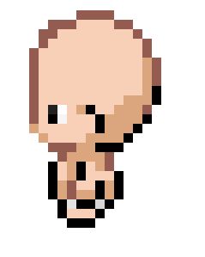
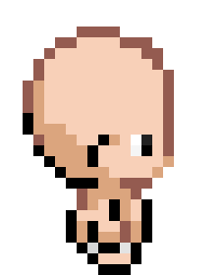
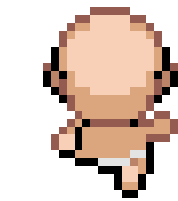
INSIGHTS: Martin
Features – Room initialization, Room layout, PNG's, Room textures, GUI implementation, Unit Testing, Image loading, JAR creation and deployment
Challenges – Implementing and using GUI for the first time.
Proud of - Creating JAR and releasing working product at each deadline
Overcoming Challenges - Reviewing existing code, debugging line by line, asking others for assistance, and utilizing resources.
Agile principle - #7 Working software is the primary measure of progress.

Slide 5

INSIGHTS: Nima
Features: Title screen, Start and Quit game, Win and Lose Game Logic, World setup for the gameplay, Layers of maps (i.e. 1st and 2nd floor, and Stairs), Display of the player's current location-room names for each room, Display map, Player/Enemies movements, Placed enemies on different rooms, Collision detection, Graphics changes for the entities like bats, Shortest path logic for enemies to follow and taunt the player, Attack logic between the player and enemies
Challenges: Implementing GUI for the first time
Proud of: World setup for the gameplay and layers of maps (i.e. 1st and 2nd floor, and Stairs)
How I overcame Challenges: Researching, watching videos and debugging the code
Agile Principle: Working software is the primary measure of progress

Slide 6

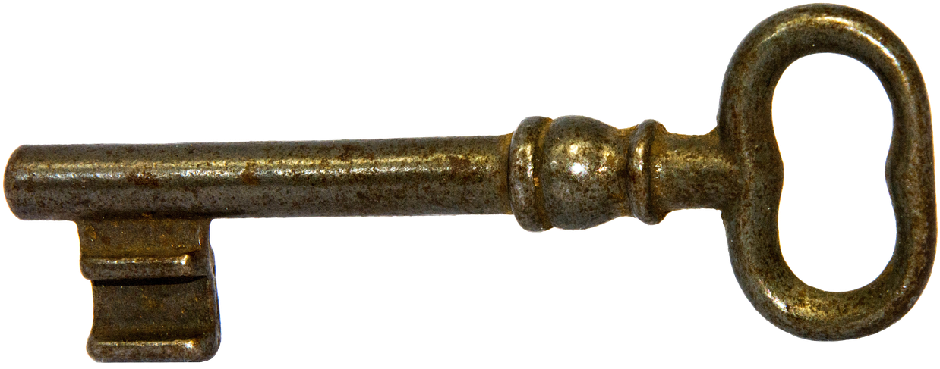
INSIGHTS: David
Features: Inventory, Sound, Equipping, Healing, Locked Doors, Player Select, Options, Settings, .png's, Improving the Console Game.
Challenges: First time GUI implementation, inheriting code, using Static and non-Static, converting ideas into code.
Proud of: Locked Doors and equipping weapons.
How I overcame Challenges: Putting in the time and going through the code one character at a time. Understanding how each usage affects a game.
Agile Principle: Satisfy the Customer

Slide 7
DEMO!!!

Slide 8
CODE REVIEW

Slide 9
What we wish we had
Changes to weapon display when attacking.
Boss fights
Changing weapons effective distance
Ghost effect environment changes
Room lighting is changed
Ability to save game
Ability to level up
Ability to track scores
Different maps
Respawn enemies after 1 minute

